Slide 1
BABITH SARISH S
NMID: FF4DF35D1062E999DE2486528E592479
Course : Generative AI for Engineering (E2324)
Madras Institute of Technology Campus, Anna University
Web Page Summarization with NLP and Emotion Analysis
Final Project :

Slide 2
PROJECT TITLE
Web Page Summarization with NLP and Emotion Analysis

Slide 3


AGENDA
1. Introduction
- Overview of the project
- Importance of web page summarization and sentiment analysis
2. Problem Statement
- Challenges in traditional web page summarization techniques
- Need for emotion-aware summarization
- Objectives of the project
3. Proposed Methodology
- Steps involved in the project:
- Web scraping
- Preprocessing
- Tokenization and word frequency calculation
- Sentence frequency calculation
- Summarization
- Sentiment analysis
4. Implementation Details
- Tools and libraries used (e.g., BeautifulSoup, NLTK, spaCy)
- Algorithms and techniques employed (e.g., TextRank, VADER)
- Technical architecture of the system

Slide 4

PROBLEM STATEMENT
In today's digital landscape, the vast amount of information available on the web presents a challenge for users to efficiently consume content. Traditional web page summarization techniques often fall short in capturing the nuances of human emotions expressed within the text, leading to summaries that may lack context and engagement. Additionally, while sentiment analysis has been widely used to gauge the emotional tone of text, it is often not integrated into summarization processes.
This project aims to address these challenges by developing an advanced web page summarization system that incorporates Natural Language Processing (NLP) techniques for both summarization and sentiment analysis. The system will extract key information from web pages, generate concise summaries, and analyze the emotional tone of the content to provide users with a more comprehensive understanding of the information presented.
The primary objective is to create a summarization system that not only provides factual information but also captures the emotional context of the text, thereby enhancing user comprehension and engagement. This system will benefit users seeking quick access to summarized content while also gaining insights into the emotional nuances of the original text.
By integrating sentiment analysis into the summarization process, this project aims to revolutionize how users consume online content, providing them with summarized content that is not only informative but also emotionally resonant.

Slide 5

PROJECT OVERVIEW
The project focuses on developing an advanced web page summarization system with integrated sentiment analysis. This system aims to address the challenges faced by users in efficiently consuming web content by providing concise summaries enriched with emotional insights.
The key components of the project include:
1. Web Scraping: Utilizing web scraping techniques to extract text content from web pages.
2. Preprocessing: Cleaning the extracted text by removing HTML tags, special characters, and irrelevant content.
3. Tokenization and Word Frequency Calculation: Breaking down the cleaned text into words and calculating the frequency of each word to identify the most important terms.
4. Sentence Frequency Calculation: Determining the frequency of each sentence based on the occurrence of important words to identify key sentences.
5. Summarization: Implementing an extractive summarization technique such as TextRank or TF-IDF to select the most relevant sentences for the summary.
6. Sentiment Analysis: Analyzing the emotional tone of the summarized content using sentiment analysis techniques such as VADER to classify the sentiment as positive, negative, or neutral.

Slide 6

WHO ARE THE END USERS?
The end users of the web page summarization system with integrated sentiment analysis could include:
1. General Internet Users: Individuals who browse the web for information and seek quick access to summarized content on various topics of interest. They may use the system to efficiently consume web content while gaining insights into the emotional tone of the information presented.
2. Researchers and Students: Academic researchers, students, and professionals who need to sift through large amounts of text for their studies or projects. They can use the system to quickly gather relevant information and understand the emotional context of the text.
3. Content Creators and Curators: Bloggers, journalists, and content creators who need to stay informed about trending topics and gather insights into public sentiment. They may use the system to monitor online discussions, identify key themes, and gauge audience reactions.

Slide 7
WHO ARE THE END USERS? - CONT
4. Market Analysts and Business Professionals: Professionals working in marketing, advertising, or market research who need to analyze public sentiment and gather insights for decision-making purposes. They can use the system to track consumer opinions, identify emerging trends, and assess brand perception.
5. Educators and Trainers: Teachers, instructors, and trainers who need to create educational materials or training content. They may use the system to gather relevant information and understand the emotional impact of the content on learners.
6. Content Aggregators and News Portals: Websites and platforms that aggregate and curate content from various sources. They can use the system to provide users with summarized news articles, blog posts, and other web content, enriched with emotional insights.

Slide 8
YOUR SOLUTION AND ITS VALUE PROPOSITION
Traditional web page summarization techniques often overlook the emotional context of the content, leading to summaries that lack depth and engagement. EmoSum addresses this limitation by leveraging sentiment analysis to capture the emotional tone of the text, thereby enhancing user comprehension and engagement.
EfficiencyThe proposal outlines a clear methodology for developing the EmoSum system, starting from web scraping and preprocessing to summarization and sentiment analysis. This systematic approach ensures that resources are utilized efficiently throughout the development process.
Flexibility: The proposal acknowledges the diverse range of potential users, including researchers, content creators, marketers, educators, and general internet users. EmoSum's user-friendly interface and customizable summarization settings cater to different user preferences and needs, ensuring flexibility in usage.
Quality: The proposal demonstrates a strong focus on delivering high-quality results through rigorous evaluation and validation processes. By comparing EmoSum's performance against existing methods and conducting user studies, the proposal aims to ensure that the system meets quality standards in terms of accuracy, coherence, and emotional relevance.

Slide 9

THE WOW IN YOUR SOLUTION
The "wow" factor in the proposal lies in its innovative integration of sentiment analysis into the web page summarization process. By incorporating emotional insights alongside key information, offers users a more holistic understanding of web content, enhancing their comprehension and engagement in a unique way. This integration adds a layer of depth and richness to the summarized content, allowing users to not only grasp the factual details but also appreciate the emotional nuances embedded within the text.
Additionally, customizable summarization settings provide a seamless and intuitive user experience, catering to a wide range of users across different domains. This aspect of flexibility ensures that can adapt to diverse user preferences and needs, making it a versatile tool for various applications, from academic research to content curation and market analysis.
Furthermore, the proposal emphasizes the rigorous evaluation and validation of performance, ensuring that the system meets high-quality standards in terms of accuracy, coherence, and emotional relevance. This commitment to excellence instills confidence in the reliability and effectiveness as a valuable tool for information retrieval and analysis in the digital age.
9

Slide 10
MODELLING
Web Scraping Model: Extract text from web pages using libraries like BeautifulSoup.
Preprocessing Model: Clean text, tokenize, and prepare it for analysis.
Summarization Model: Select key sentences using TextRank or TF-IDF.
Sentiment Analysis Model: Analyze emotional tone using methods like VADER or LSTM.
Integration Model: Integrate summarization and sentiment analysis into EmoSum.
Evaluation Model: Define metrics, conduct experiments, and gather feedback for refinement.
10

Slide 11
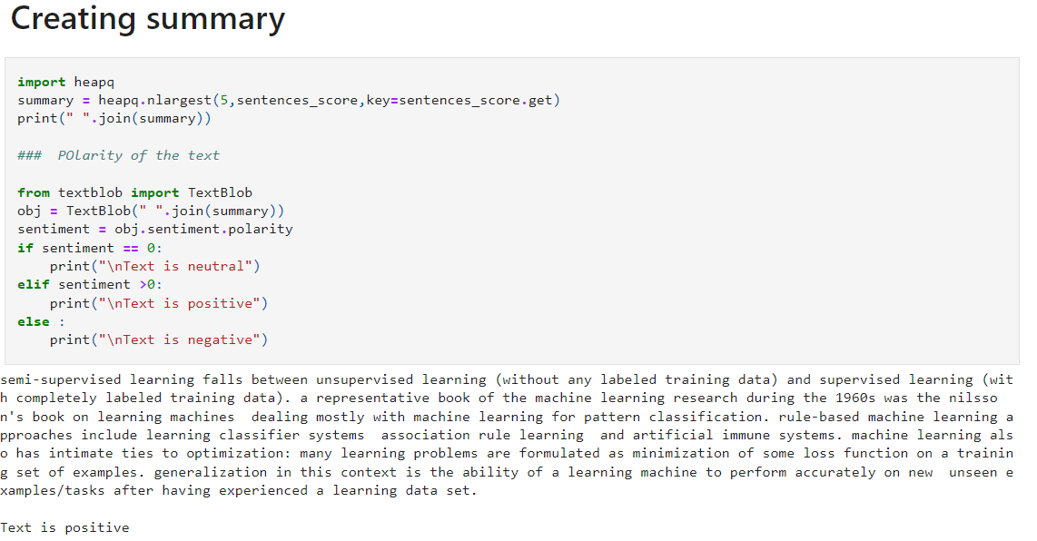
RESULTS
In the results phase, we assess the effectiveness of web scraping in extracting text content and the quality of preprocessing tasks. We evaluate the summarization model's performance in generating concise summaries and the sentiment analysis model's accuracy in classifying emotional tone. Integration results consider overall system performance and usability, while evaluation metrics encompass accuracy, coherence, emotional relevance, and user satisfaction. Comparison with existing methods highlights advantages. Future directions focus on enhancing effectiveness and scalability.
11

